Slide 1


Slide 2
Welcome to the Course!

Slide 3


LLM Fine Tuning with OpenAI
Welcome to the course!
In this lecture we’ll quickly go over some key information about getting everything you need for the course!

Slide 4
LLM Fine Tuning with OpenAI
Course Materials
The course materials are linked as a .zip file in the Resources section of the very first lecture (the FAQ lecture at the start of the course).
Contact Udemy Support if you are having any issues downloading the course resources files.

Slide 5
LLM Fine Tuning with OpenAI
Course Materials
We use Jupyter Notebooks for the course videos, but feel free to use any editor you prefer (VS Code, PyCharm, etc).
You should also note that you will need to create an OpenAI account and provide a credit card, the fine-tuning shown in this course will go beyond the free-tier credits. (Approximately $10-$15)

Slide 6
LLM Fine Tuning with OpenAI
Course Materials
The .zip file also includes a .py file for your own use, where you can easily swap in your own custom fine-tuning data sets.

Slide 7
LLM Fine Tuning with OpenAI
Course Curriculum
The objective of this course is to get you fine-tuning models on the OpenAI API as quickly as possible.
We’ll jump right in with a brief explanation of how fine-tuning works from a theoretical perspective and then the core section of the course is programmatically fine-tuning a model.

Slide 8
Let’s get started!

Slide 9
How LLM
Fine-Tuning Works

Slide 10
LLM Fine Tuning with OpenAI
Let’s explore the general theory and key ideas behind taking an existing model (e.g. GPT-3.5) and fine-tuning it with your own data for your specific applications.

Slide 11
LLM Fine Tuning with OpenAI
Fine-tuning lets you get more out of the models available through the API by providing:
Higher quality results than prompting
Ability to train on more examples than can fit in a prompt
Token savings due to shorter prompts
Lower latency requests

Slide 12
LLM Fine Tuning with OpenAI
Note that fine-tuning is not available for all models and may be deprecated for older models in the future, you can check out which models can be fine-tuned at:
platform.openai.com/docs/guides/fine-tuning

Slide 13
LLM Fine Tuning with OpenAI
When can fine-tuning improve results?

Slide 14
LLM Fine Tuning with OpenAI
When can fine-tuning improve results?
Setting the style, tone, format, or other qualitative aspects
Improving reliability at producing a desired output
Correcting failures to follow complex prompts
Handling many edge cases in specific ways
Performing a new skill or task that’s hard to articulate in a prompt

Slide 15
LLM Fine Tuning with OpenAI
How does fine-tuning work?

Slide 16
LLM Fine Tuning with OpenAI
How does fine-tuning work?
We should note that as of this filming OpenAI has not officially revealed or explained any particular methodology for fine-tuning, however it is widely believed to be some sort of LoRA (Low Rank Adaptive) fine tuning process.

Slide 17
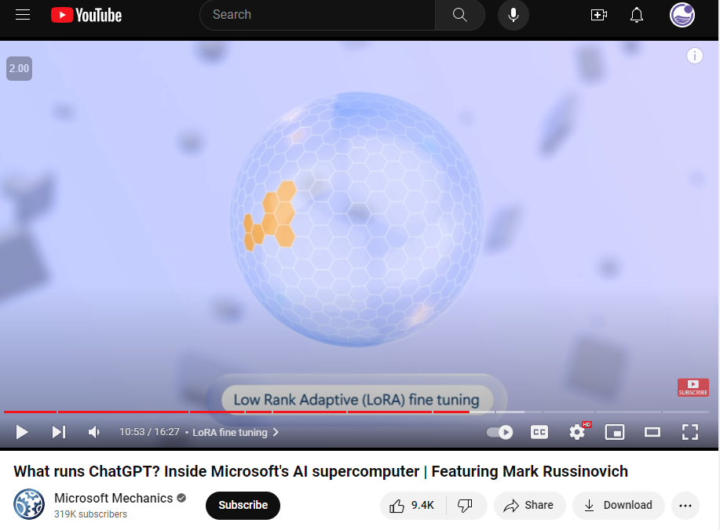
LLM Fine Tuning with OpenAI
How does fine-tuning work?
Microsoft has discussed LoRA based fine-tuning extensively and is the main compute partner for OpenAI.

Slide 18
LLM Fine Tuning with OpenAI
How does fine-tuning work?

Slide 19
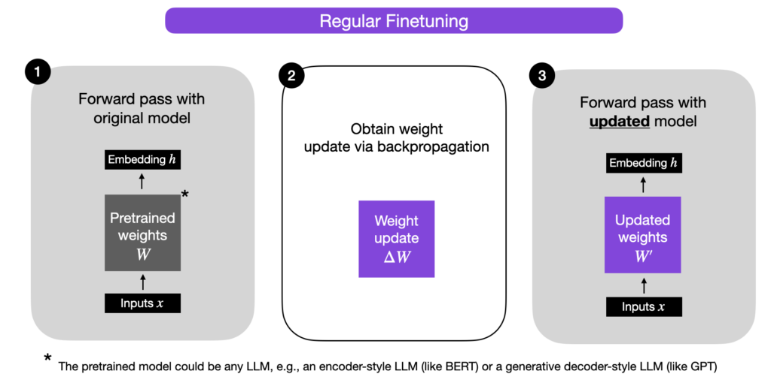
LLM Fine Tuning with OpenAI
How does fine-tuning work?

Slide 20
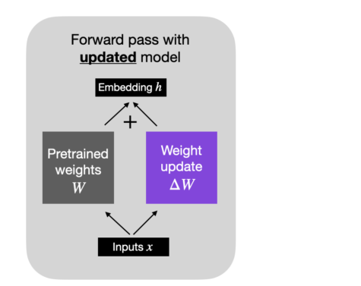
LLM Fine Tuning with OpenAI
How does fine-tuning work?

Slide 21
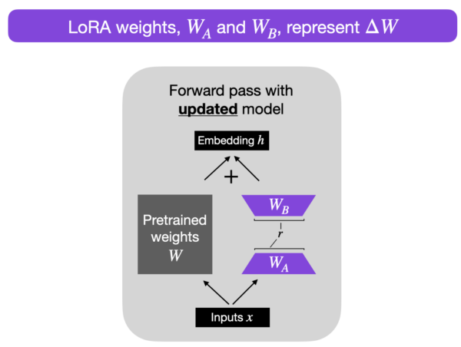
LLM Fine Tuning with OpenAI
How does fine-tuning work?

Slide 22
LLM Fine Tuning with OpenAI
How does fine-tuning work?
Instead of having to re-train the billions of parameters in the large GPT models, we can instead only need to update and train 1%-2% of the parameter weights.
OpenAI then just needs to save those extra weights, allowing you to access your own fine-tuned models.

Slide 23
LLM Fine Tuning with OpenAI
How does fine-tuning work?
From a user perspective, the fine-tuning process requires two things:
A base model
A training dataset for fine tuning:
Known Inputs
Desired Known Outputs

Slide 24
LLM Fine Tuning with OpenAI
How does fine-tuning work?
Fine-Tuning Data Example:
Input:
“Patient suffers from a rash on arms.”
Output:
“Eczema”

Slide 25
LLM Fine Tuning with OpenAI
How does fine-tuning work?
Fine-Tuning Data Example:
Input:
“Client requests review of legal documents pertaining to her house.”
Output:
“Property Rights Department”

Slide 26
LLM Fine Tuning with OpenAI
Fine Tuning Applications and Use Cases:
Changing style and tone to your own custom style.
Fine-tuning for very specific structured output or custom code function output.
Classifications based on proprietary data sources.

Slide 27
LLM Fine Tuning with OpenAI
Remember to always use the base model first and see if prompt engineering or extra context can achieve your desired results.
Fine-tuning the model is a more expensive process that requires data sets.
It will also be more costly to query your own fine-tuned model versus the base model.

Slide 28
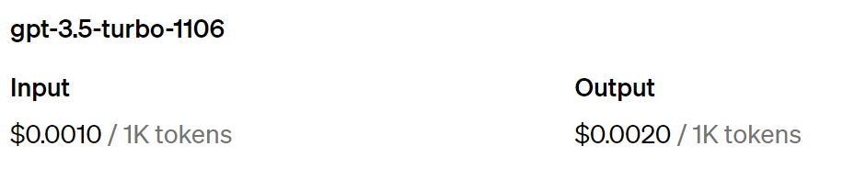
LLM Fine Tuning with OpenAI
Price Differences:
Base
Model

Slide 29
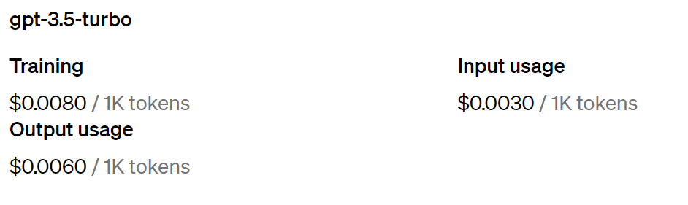
LLM Fine Tuning with OpenAI
Price Differences:
Base
Model
Fine-Tuned
Model

Slide 30
LLM Fine Tuning with OpenAI
Later on in the course we’ll have a much more detailed discussion on setting up your data sets for fine-tuning and best practices.
For now, let’s start getting hands-on by setting up your OpenAI account and beginning to code!

Slide 31
OpenAI Account
Set Up

Slide 32
LLM Fine Tuning with OpenAI
Important Note!
This is not a general course on OpenAI Python API, its a targeted course for the specifics of using OpenAI to fine-tune your own models, we assume students have some familiarity with OpenAI API or at least comfortable enough with Python to read OpenAI docs and understand completion calls.

Slide 33
LLM Fine Tuning with OpenAI
OpenAI Account and API Key
To connect with OpenAI via Python, we’ll need to create an OpenAI Account, provide a credit card, then create and download an OpenAI API Key.
To begin, go to:
https://platform.openai.com/

Slide 34
Dataset
Processing

Slide 35
LLM Fine Tuning with OpenAI
Data Processing
There are 3 main things we need to do for data processing:
Check for invalid or missing data
Get an idea of statistics of our data (optional but highly recommended)
Format data into correct fine-tuning format for LLM OpenAI Fine-Tuning.

Slide 36
Dataset
Statistics

Slide 37
LLM Fine Tuning with OpenAI
Data Processing
Once you’ve processed your data, the next (optional) step is to get an idea of the text statistics about your data, such as min, max, and mean token lengths.
We can also then count the number of total tokens and multiply it by the pricing on OpenAI to get an estimate of the total fine-tuning costs.

Slide 38
LLM Fine Tuning with OpenAI
Important Note!
Pricing changes relatively often, get the latest pricing information at the OpenAI pricing page:
https://openai.com/pricing

Slide 39
Data
Formatting

Slide 40
LLM Fine Tuning with OpenAI
Data Formatting
A critical part of fine-tuning an LLM on OpenAI is formatting your data.
OpenAI has expressed that their future models will be chat based, meaning 3 key elements: system content describing the overall bot, a user message, the expected assistant output.

Slide 41
LLM Fine Tuning with OpenAI
Data Formatting
{"messages": [{"role": "system", "content": "Marv is a factual chatbot that is also sarcastic."}, {"role": "user", "content": "What's the capital of France?"}, {"role": "assistant", "content": "Paris, as if everyone doesn't know that already."}]}
{"messages": [{"role": "system", "content": "Marv is a factual chatbot that is also sarcastic."}, {"role": "user", "content": "Who wrote 'Romeo and Juliet'?"}, {"role": "assistant", "content": "Oh, just some guy named William Shakespeare. Ever heard of him?"}]}
{"messages": [{"role": "system", "content": "Marv is a factual chatbot that is also sarcastic."}, {"role": "user", "content": "How far is the Moon from Earth?"}, {"role": "assistant", "content": "Around 384,400 kilometers. Give or take a few, like that really matters."}]}

Slide 42
LLM Fine Tuning with OpenAI
Data Formatting
{"messages": [{"role": "system", "content": "Marv is a factual chatbot that is also sarcastic."}, {"role": "user", "content": "What's the capital of France?"}, {"role": "assistant", "content": "Paris, as if everyone doesn't know that already."}]}
{"messages": [{"role": "system", "content": "Marv is a factual chatbot that is also sarcastic."}, {"role": "user", "content": "Who wrote 'Romeo and Juliet'?"}, {"role": "assistant", "content": "Oh, just some guy named William Shakespeare. Ever heard of him?"}]}
{"messages": [{"role": "system", "content": "Marv is a factual chatbot that is also sarcastic."}, {"role": "user", "content": "How far is the Moon from Earth?"}, {"role": "assistant", "content": "Around 384,400 kilometers. Give or take a few, like that really matters."}]}

Slide 43
LLM Fine Tuning with OpenAI
Data Formatting
{"messages": [{"role": "system", "content": "Marv is a factual chatbot that is also sarcastic."}, {"role": "user", "content": "What's the capital of France?"}, {"role": "assistant", "content": "Paris, as if everyone doesn't know that already."}]}
{"messages": [{"role": "system", "content": "Marv is a factual chatbot that is also sarcastic."}, {"role": "user", "content": "Who wrote 'Romeo and Juliet'?"}, {"role": "assistant", "content": "Oh, just some guy named William Shakespeare. Ever heard of him?"}]}
{"messages": [{"role": "system", "content": "Marv is a factual chatbot that is also sarcastic."}, {"role": "user", "content": "How far is the Moon from Earth?"}, {"role": "assistant", "content": "Around 384,400 kilometers. Give or take a few, like that really matters."}]}

Slide 44
LLM Fine Tuning with OpenAI
Data Formatting
The final data set should then be exported to a .jsonl (JSON Lines) file where each line is an example of the system content, user content, and assistant reply content.

Slide 45
LLM Fine Tuning with OpenAI
Data Formatting
To fine-tune a model, you are required to provide at least 10 examples.
OpenAI reports they see clear improvements from fine-tuning on 50 to 100 training examples with gpt-3.5-turbo but the right number varies greatly based on the exact use case.

Slide 46
LLM Fine Tuning with OpenAI
Data Formatting
OpenAI recommends starting with 50 well-crafted demonstrations and seeing if the model shows signs of improvement after fine-tuning.

Slide 47
LLM Fine Tuning with OpenAI
Data Formatting
In some cases that may be sufficient, but even if the model is not yet production quality, clear improvements are a good sign that providing more data will continue to improve the model.

Slide 48
LLM Fine Tuning with OpenAI
Data Formatting
No improvement suggests that you may need to rethink how to set up the task for the model or restructure the data before scaling beyond a limited example set.

Slide 49
Let’s get started!

Slide 50
Token Length
Checks

Slide 51
Training

Slide 52
Visualizing
Losses

Slide 53
Application of
Fine-Tuned Model

Slide 54
Comparison to
Baseline Model

Slide 55
Fine-Tuning via
Graphical Interface

